Slide 1

Group 4
Apple Siri Privacy Lawsuit Settlement
MSE 505: Engineering Decision Analysis
Prof: Salpy Tovar
Presented By
Anuhya Dudi
Prajwal Suresh Kurtkoti
Poornesh Benachanahalli Suresh
Samradh Ganesh Shetty
Tejesh Kumar Nunela

Slide 2

Apple Siri Lawsuit
Table of Contents
01
07
Introduction
Sensitivity Analysis
02
08
Problem Overview
Tornado Diagram
03
09
Project Scope
Risk Profile Analysis
04
10
Cause and Effect Diagram
Conclusion
05
11
Methodology
Recommendations
06
12
Decision Tree Analysis
References

Slide 3
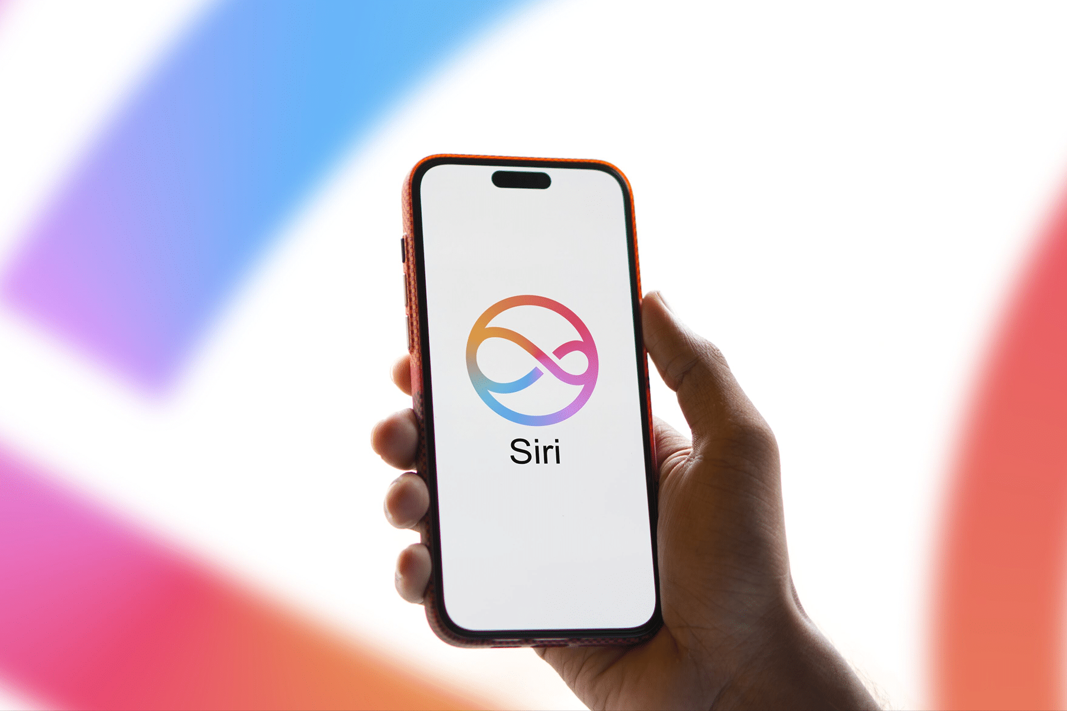
Apple Siri Lawsuit
Introduction
In recent years, Apple faced a class-action lawsuit involving its virtual assistant, Siri. Users alleged that Siri was recording conversations without consent, raising serious privacy concerns.
Apple, known for strong privacy policies, risked losing user trust and faced significant legal and financial consequences. The case received wide media attention and posed potential reputational damage to Apple’s brand.

Slide 4
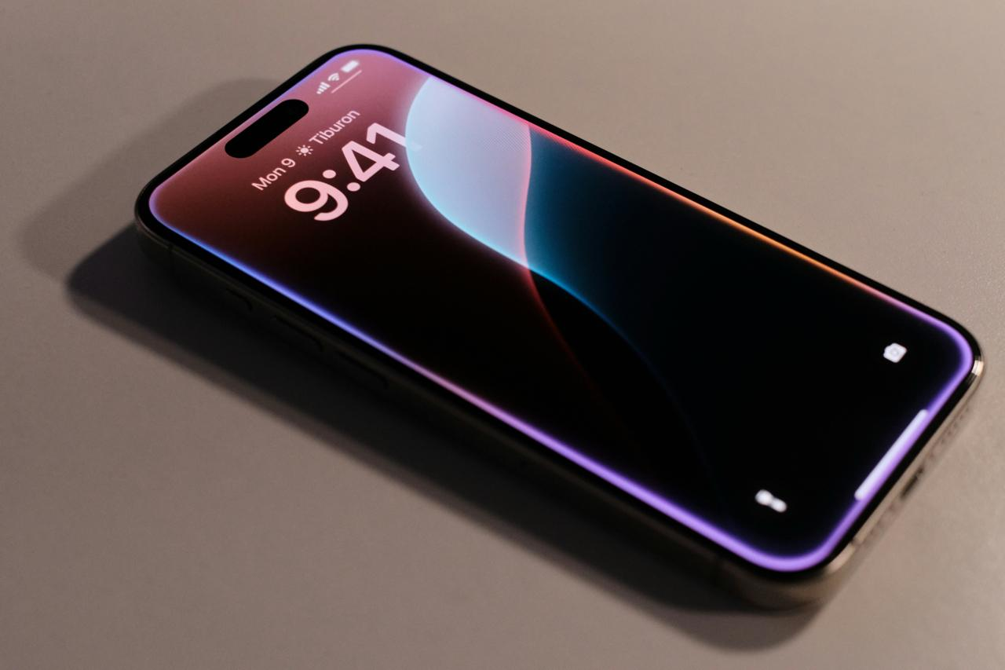
Apple Siri Lawsuit
Problem Overview
Apple faced a class-action lawsuit alleging that Siri was recording private conversations without user consent. The lawsuit accused Apple of violating user privacy and breaching its own privacy policies.
Key Challenges for Apple:
Legal Risk: Potentially high legal costs if the case went to trial.
Financial Risk: Significant settlement costs or damages could impact profitability.
Reputational Risk: Damage to Apple's public image as a privacy-first company.
User Trust: Loss of consumer confidence affecting long-term customer loyalty.

Slide 5
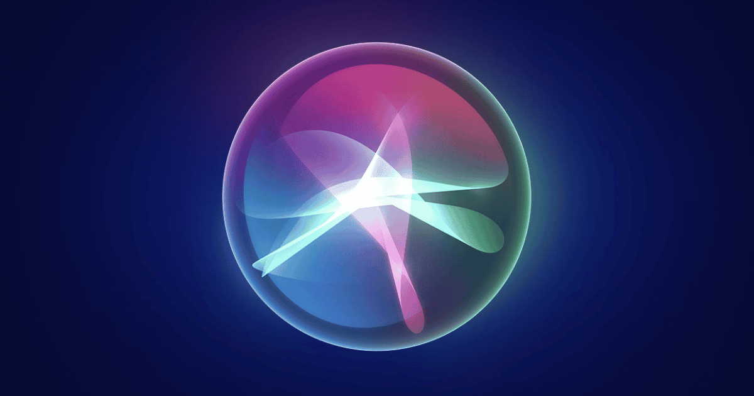
Apple Siri Lawsuit
Project Scope
Our project aims to understand and provide a framework that any high- profile companies like Apple can use this in Legal Situations involving consumer privacy.
Scope of Study Includes
Evaluating Apple’s options: settlement vs. trial.
Assessing impacts on user privacy, financial liabilities, legal exposure, and brand reputation.
Applying structured decision analysis tools to simulate and compare outcomes.
What We Are Analyzing
Apple’s strategic decision-making process in the Siri privacy lawsuit context.

Slide 6
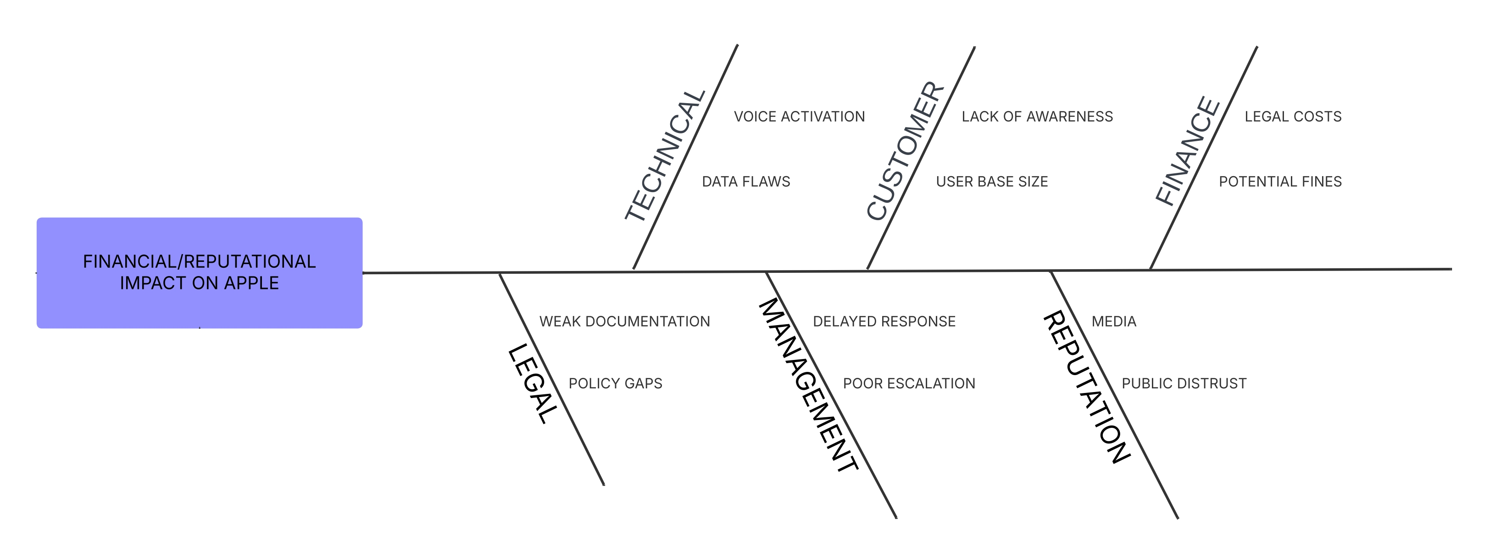
Apple Siri Lawsuit
Cause and Effect Diagram

Slide 7
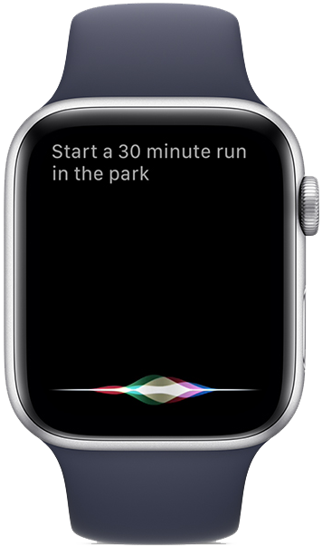
Apple Siri Lawsuit
Methodology
Decision Tree
Sensitivity Analysis
To map out Apple’s options (settlement vs. trial) and visualize possible outcomes with associated probabilities.
To identify which variables (e.g., legal costs, public backlash) have the greatest impact on Apple’s decision.
Risk Profile
Probability Models
To evaluate the risk appetite and expected losses or gains under various scenarios for Apple.
To assign and analyze likelihoods for trial outcomes, public response, and financial damages.

Slide 8
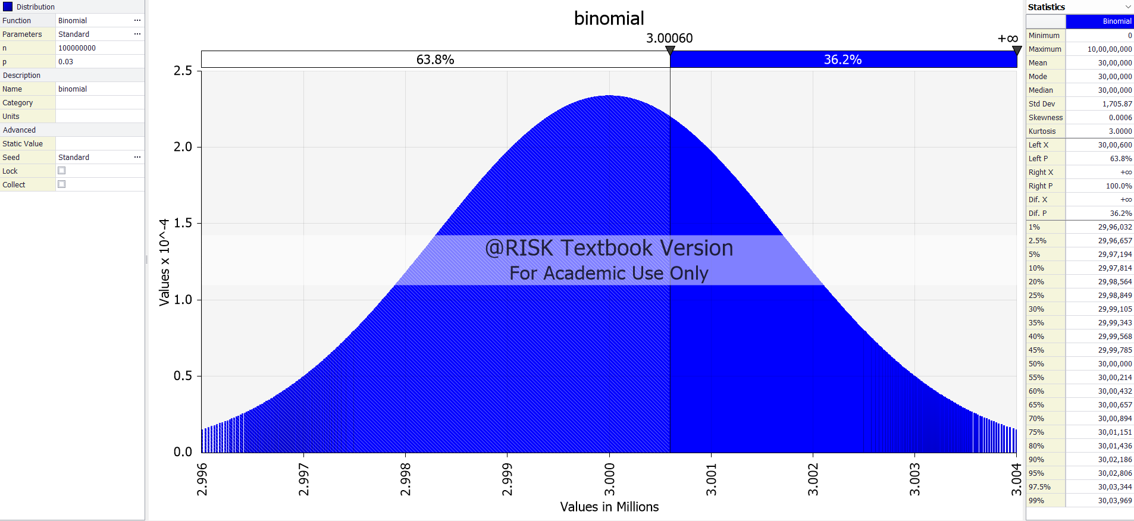
Apple Siri Lawsuit
Binomial Distribution

Slide 9

Apple Siri Lawsuit
Binomial Distribution
Binomial Distribution – 100 Million Active Apple Users
Key Observations
Based on 100 million users, each with a 3% chance of filing a claim.
The distribution is smooth and nearly normal due to the large sample size.
Mean and Median are centred at 3,000,000 claimants.
Standard Deviation remains ~1.7 Million.
63.8% probability that 3 million or fewer users will claim.
Useful for precise risk modelling and payout forecasts at population scale.

Slide 10
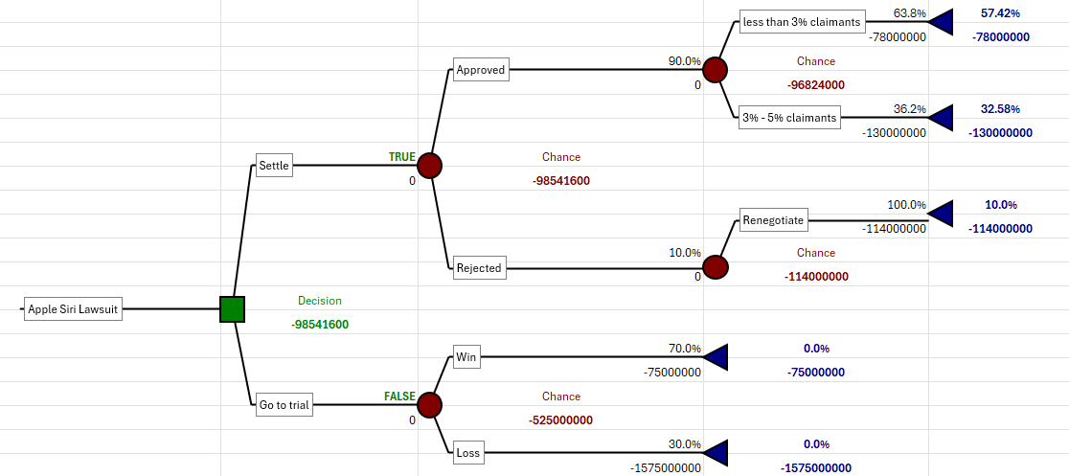
Apple Siri Lawsuit
Decision Tree

Slide 11
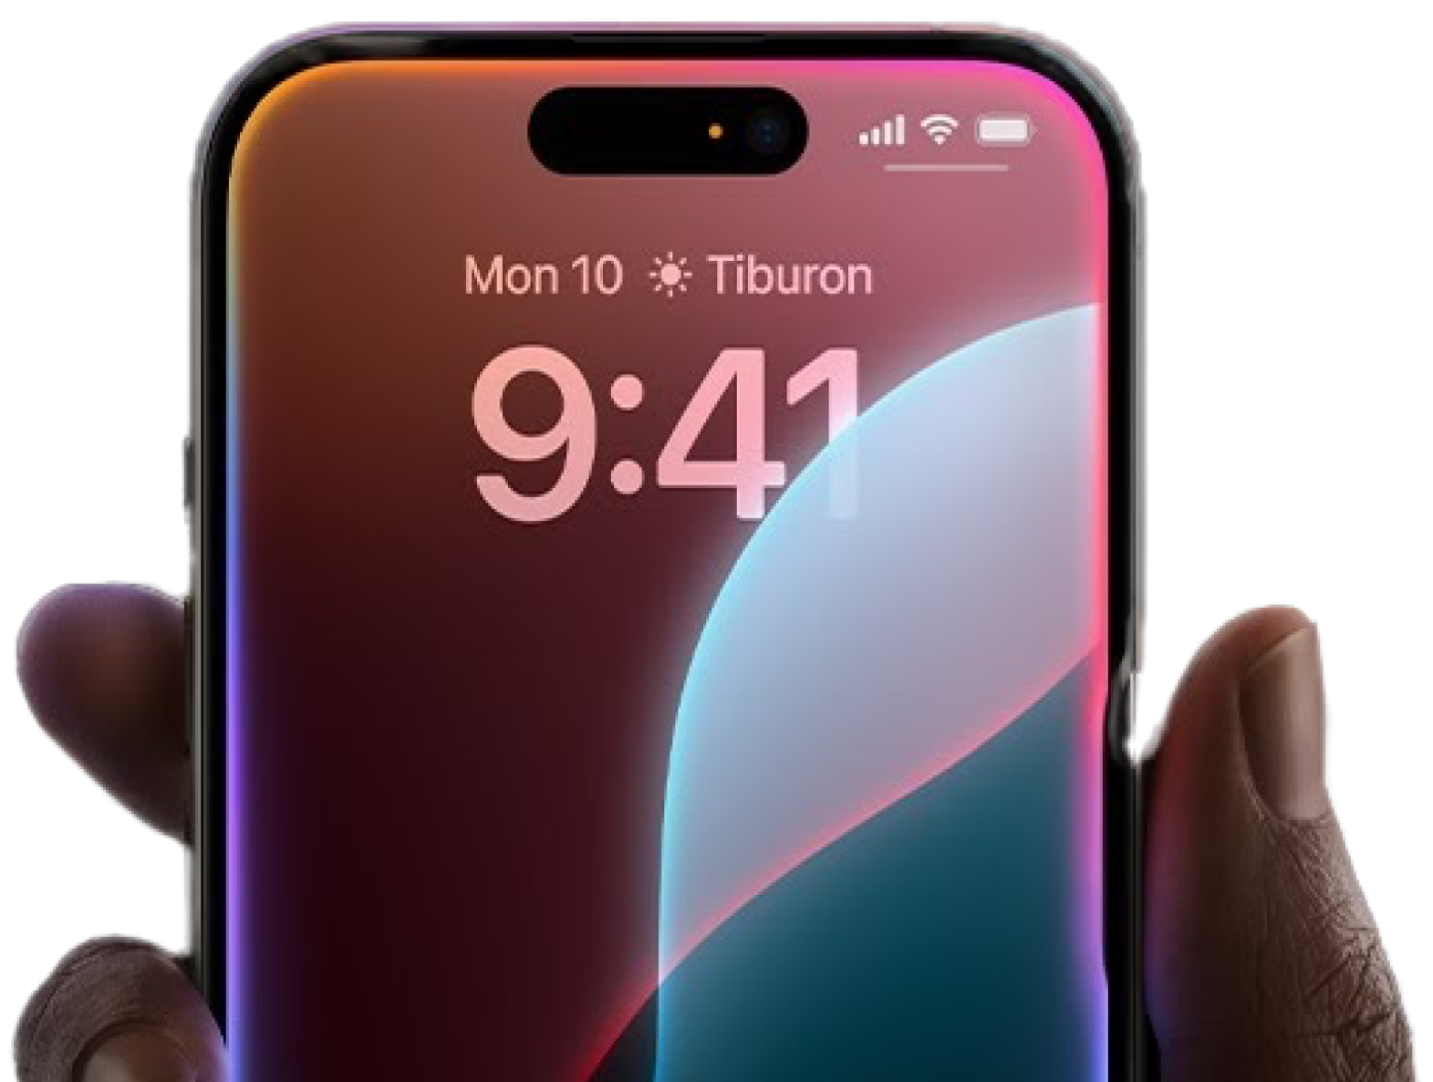
Apple Siri Lawsuit
Decision Tree Analysis
The decision tree outlines two main strategic options for Apple regarding the Siri lawsuit:
Settle the case
Go to trial
Key Observations
A 10% chance exists that the settlement could be rejected, forcing Apple to renegotiate or go to trial potentially costing up to $157.5M.
If Approved:
63.8% chance of less than 3% claimants, resulting in $78M cost.
36.2% chance of 3% - 5% claimants, with a higher payout of $130M.
If Rejected (10% chance): leads to renegotiation, costing $!14M.
If Apple goes directly to trial, there's a 70% chance of winning (cost: $75M) and a 30% risk of losing (cost: $157.5M).

Slide 12
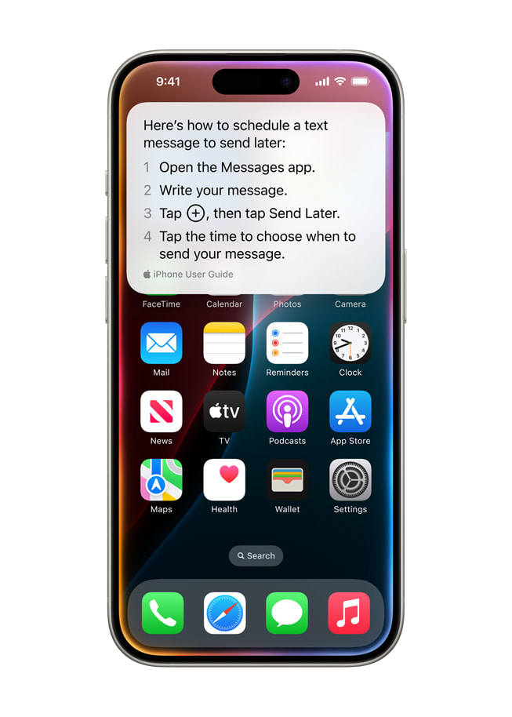
Apple Siri Lawsuit
Expected Monetary Value
Settle Option
90% chance of approval → EMV = (63.8% x $-78,000,000) + (36.2% x $-130,000,000)
10% chance of rejection → Renegotiation Cost = $-114,000,000
Total EMV (Settle) = $-98,541,600.00
Trial Option
70% chance of winning → Cost = $-75,000,000
30% chance of losing → Cost = $-157,500,000
Total EMV (Trial) = $--525,000,000
Recommendation
Choose the option with the higher (less negative) EMV → Preferred: Settle

Slide 13
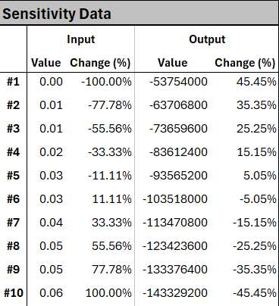
Apple Siri Lawsuit
Sensitivity Analysis
Sensitivity of Claim Rate
As the claim rate increases, the expected cost worsens significantly, showing a near-linear negative impact on financial outcomes from -$50M to $144M.
This highlights that small increases in minimum claimant estimates can drastically increase expected costs, making claim rate a highly sensitive input.

Slide 14
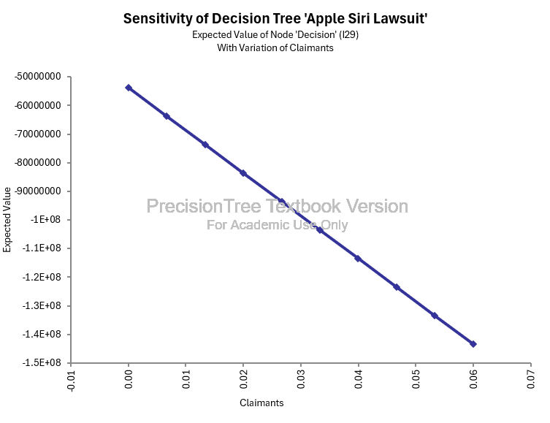
Apple Siri Lawsuit
Sensitivity Analysis

Slide 15
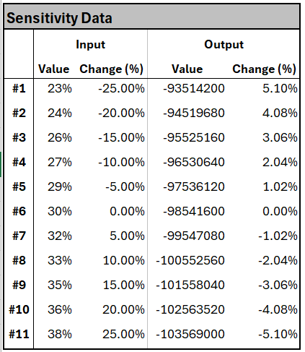
Apple Siri Lawsuit
Sensitivity Analysis
Sensitivity of Legal Fees
While legal fees have a moderate impact on outcomes (±25%), optimizing them can still lead to significant savings.
The sensitivity analysis shows that varying legal fees from 23% to 38% shifts the expected loss from –$93.5M to –$103.6M, a total swing of around $10 million.
Compared to Claim Rate, Legal fees has a more moderate impact, but it still plays a role in shifting the financial risk profile for Apple.

Slide 16
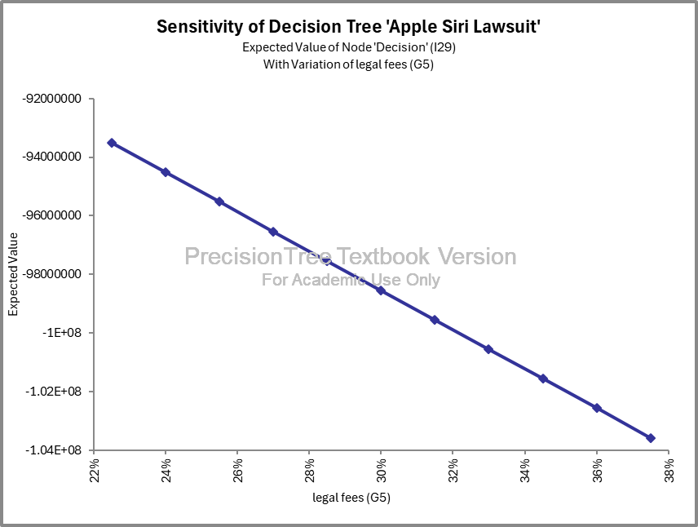
Apple Siri Lawsuit
Sensitivity Analysis

Slide 17
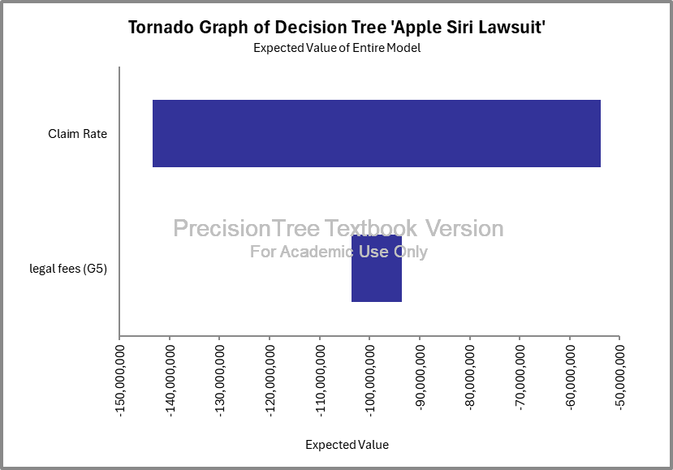
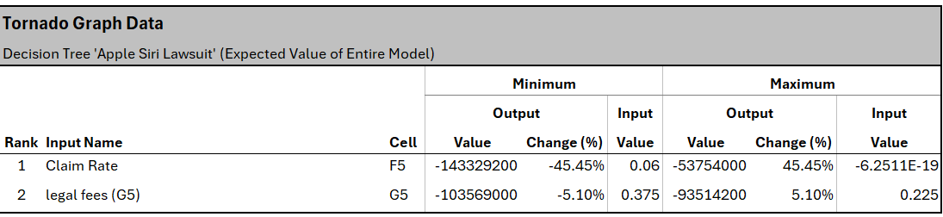
Apple Siri Lawsuit
Tornado Diagram

Slide 18
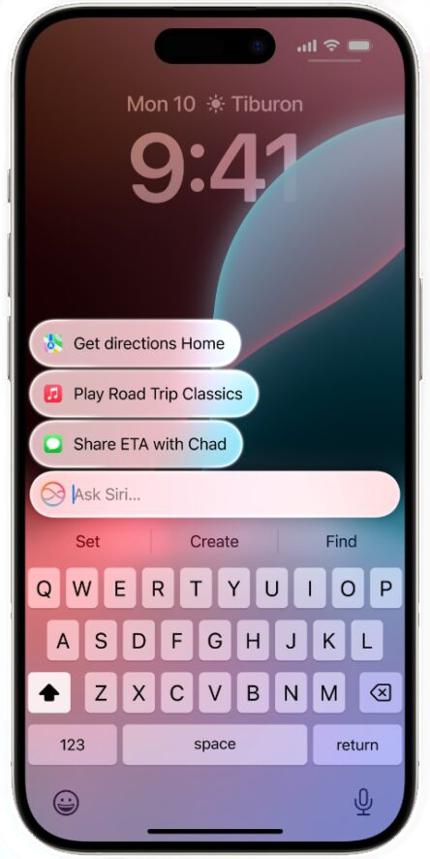
Apple Siri Lawsuit
Tornado Diagram
Claim Rate:
Most influential variable on the outcome.
Changing claim rate from 6% to 0.06% shifts expected value from –$143M to –$54M.
Total swing of $90M, representing a ±45.45% change in expected value.
Interpretation: Even slight increases in claim rate drastically increase potential losses.
Legal Fees:
Less sensitive than claim rate but still impactful.
Varying legal fees from 37.5% to 22.5% changes the expected value between –$103.6M and –$93.5M.
Approx. ±5.1% change in expected value.
Interpretation: Legal fee fluctuations have moderate effect on total expected loss.

Slide 19
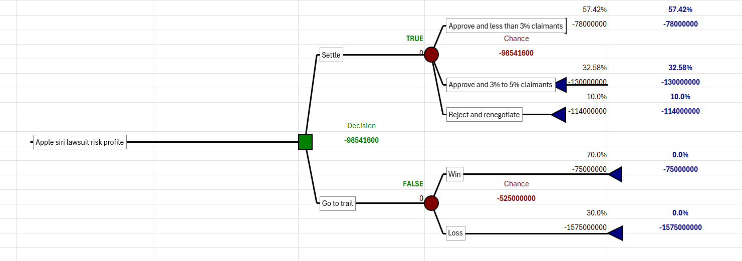
Apple Siri Lawsuit
Risk Profile Analysis
Reconstructed Decision tree

Slide 20
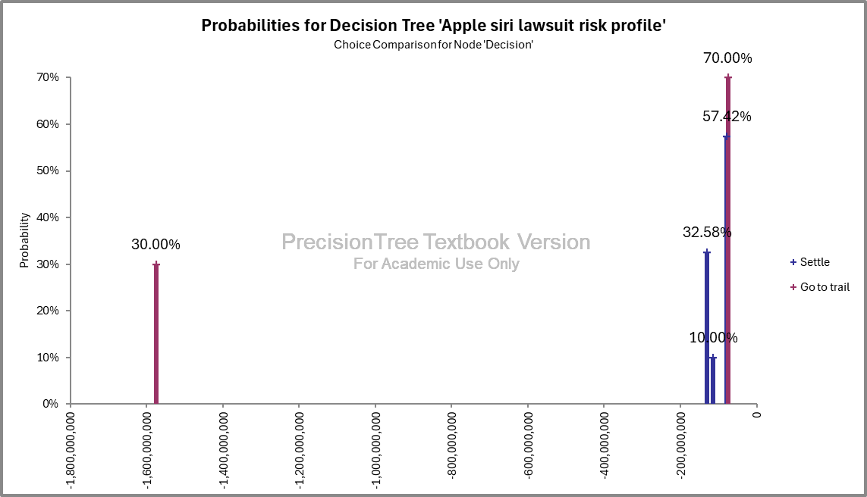
Apple Siri Lawsuit
Risk Profile Analysis

Slide 21
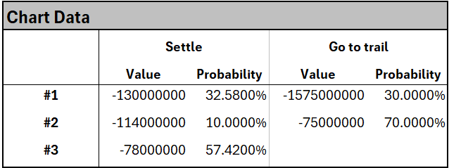
Apple Siri Lawsuit
Risk Profile Analysis
The chart shows that settling the lawsuit has a 57.42% probability of a moderate loss (−$78M), while 32.58% and 10% chances exist for larger losses (−$130M and −$114M respectively).
In contrast, going to trial offers a 70% chance of a low loss (−$75M) if Apple wins, but also a 30% risk of a severe loss (−$1.575B) if it loses.
Although trial has a higher chance of minimal payout, the magnitude of potential loss makes it significantly riskier than the more stable and predictable settlement option.

Slide 22
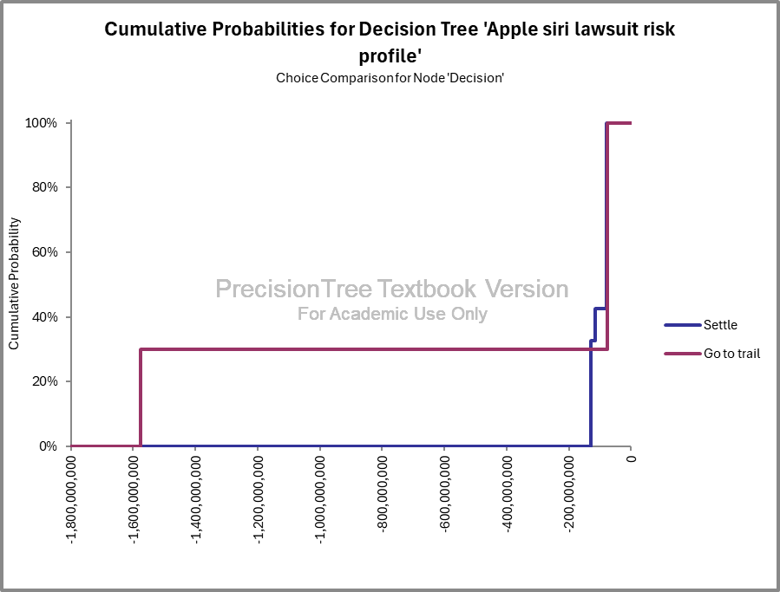
Apple Siri Lawsuit
Risk Profile Analysis

Slide 23
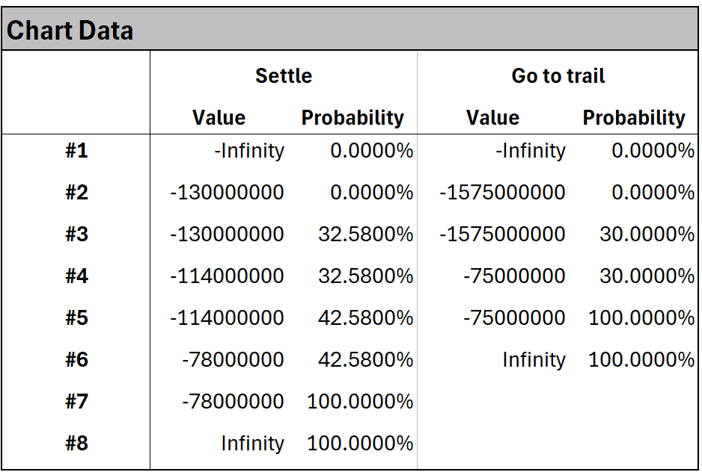
Apple Siri Lawsuit
Risk Profile Analysis
Cumulative Probability Curve
The "Go to trial" curve shows a steep jump at a $1.575B loss with 30% probability, signaling a high early risk. In contrast, the "Settle" curve increases gradually, reaching 100% certainty between −$130M and −$78M, indicating a more stable and predictable outcome.
This visual comparison highlights that settlement offers lower financial volatility, while trial exposes Apple to significant downside risk early on.

Slide 24
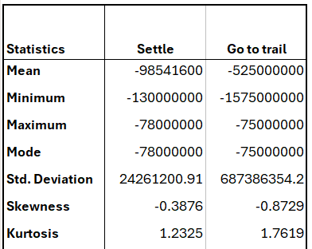
Apple Siri Lawsuit
Risk Profile Analysis
Summary
Lower Risk: Settlement has a lower average loss (–$98.5M) compared to trial (–$525M).
Less Variability: Standard deviation is much smaller for settlement ($24.3M) than for trial ($687.4M), indicating more predictable outcomes.
Higher Risk in Trial: Trial outcomes show greater skewness (–0.87) and kurtosis (1.76), signaling higher risk of extreme losses, up to –$1.575B.

Slide 25
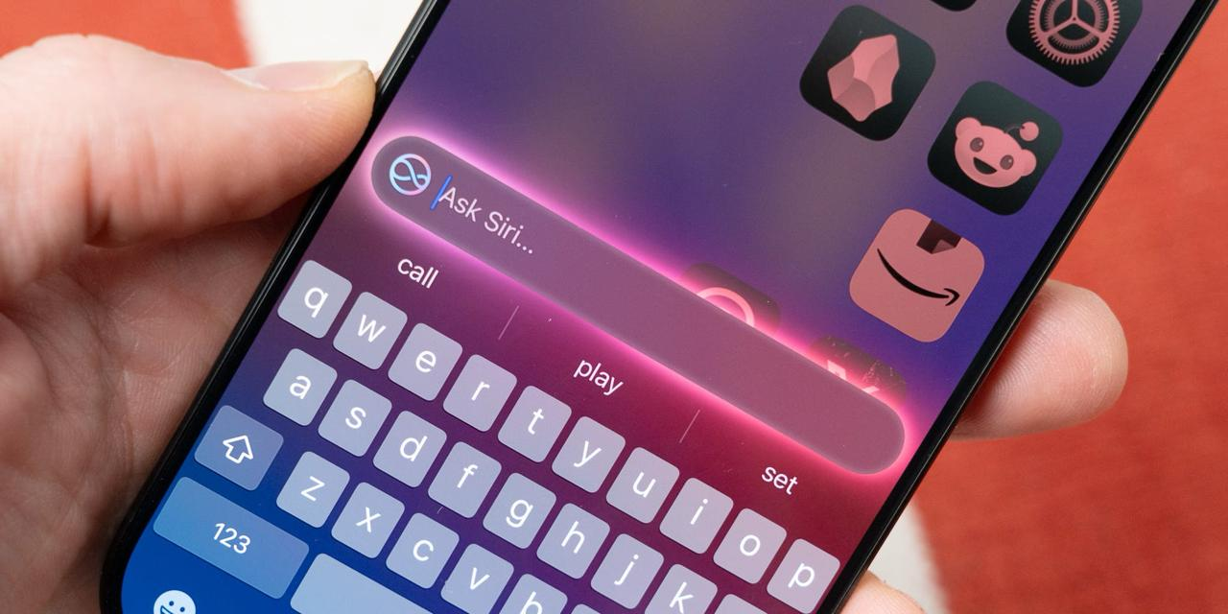
Apple Siri Lawsuit
Conclusion
Informed Decision – Making with Analytical Tools
Applied Decision Trees, Risk Profiles, Probability Models, and Sensitivity Analysis
Found that trail may seam cheaper, but involves high downside risk and brand damage.
Expected Financial Impact (Mean)
Settling the lawsuit has an expected cost of $98.54 million.
Going to trail presents an expected cost of 525 million.
Worst – Case Scenarios (Maximum Loss)
If the case goes to trail, losses could rise to $1.575 billion in the worst-case scenario.
Settling caps potential losses at $130 million.

Slide 26
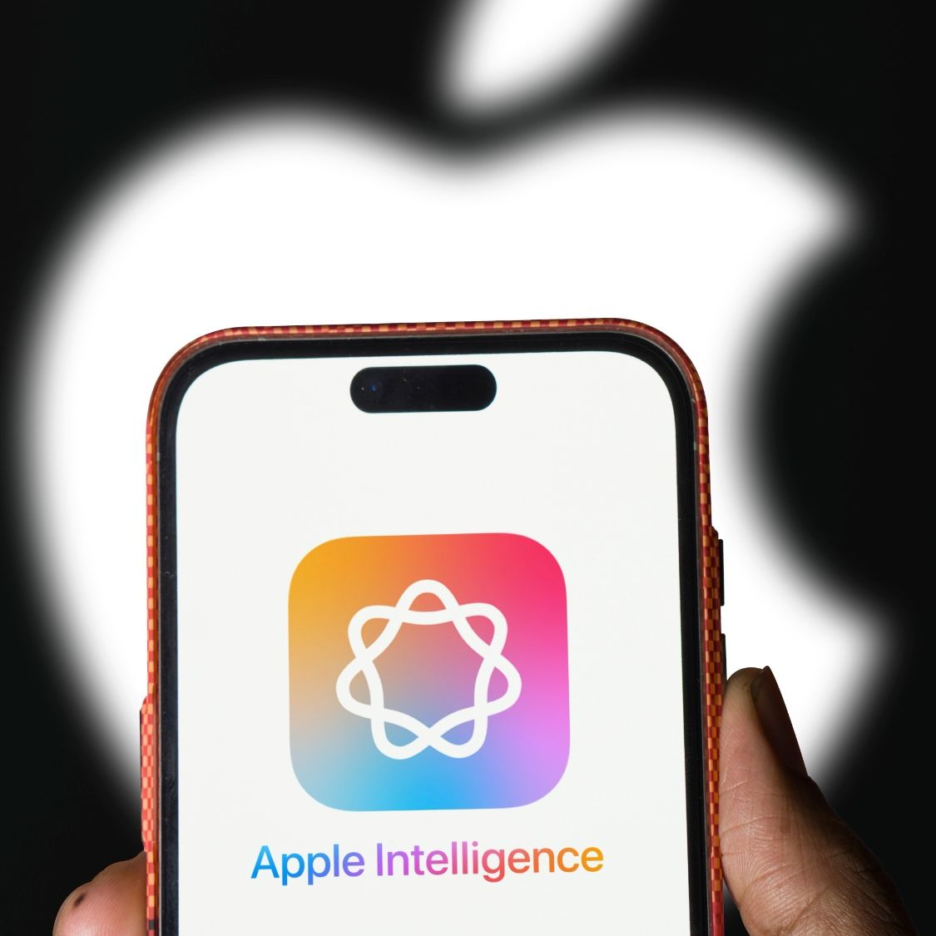
Apple Siri Lawsuit
Recommendations
Apple should opt for early settlement to:
Lower long-term risk
Protect brand trust
Ensure a quicker, controlled resolution

Slide 27
Apple Siri Lawsuit
References
Sterkel, C. (2025, January 2). Apple settles $95 million lawsuit over Siri eavesdropping allegations. Ed White Law. https://www.edwhitelaw.com/blog/apple-settles-95-million-lawsuit-over-siri-eavesdropping-allegations
Kerner, S. M. (2025, January 3). Apple lawsuit history explained. WhatIs. https://www.techtarget.com/whatis/feature/Apple-lawsuit-history-explained
Abbott, A. (2024, May 9). U.S. v. Apple lawsuit could affect American competition and Innovation. Forbes. https://www.forbes.com/sites/aldenabbott/2024/03/22/us-v-apple-lawsuit-could-affect-us-competition-and-innovation/
O’Flaherty, K. (2025, January 6). Apple Siri eavesdropping payout - here’s who’s eligible and how to claim. Forbes. https://www.forbes.com/sites/kateoflahertyuk/2025/01/06/apple-siri-eavesdropping-payout-heres-whos-eligible-and-how-to-claim/
Wikimedia Foundation. (2025, March 16). Litigation involving Apple Inc.. Wikipedia. https://en.wikipedia.org/wiki/Litigation_involving_Apple_Inc.#Consumer_class_actions
Laricchia, F. (2024, May 17). U.S. number of active iPhone Units 2023. Statista. https://www.statista.com/statistics/1337723/active-apple-iphone-units-in-the-us/
Singh, S. (2025, March 27). IPhone users & sales statistics 2025 [worldwide data]. DemandSage. https://www.demandsage.com/iphone-user-statistics/#:~:text=151.3%20million%20iPhones%20were%20sold,usage%2C%20sales%2C%20and%20more
Robertson, A. (2025, January 2). Apple will pay $95 million to people who were spied on by Siri. The Verge. https://www.theverge.com/2025/1/2/24334268/apple-siri-recording-privacy-lawsuit-settlement-proposed
Lin, A. (2021, September 2). Apple must face claim that Siri violates privacy, judge says (1). Bloomberg Law. https://news.bloomberglaw.com/privacy-and-data-security/apple-must-face-claim-that-siri-violates-privacy-judge-rules?context=search&index=5
Clough, C. (2025, January 2). Apple reaches $95m privacy deal with millions of Siri users. Law360. https://www.law360.com/articles/2278805/apple-reaches-95m-privacy-deal-with-millions-of-siri-users

Slide 28
Apple Siri Lawsuit
Thank You

